Slide 1
EE204: Computer Architecture
Week 2
Lecture 3

Slide 2
Review: Design of ALU
Today we are going to review the basic design of ALU
The microoperations most often encountered in digital computers are classified into four categories:
  Register transfer microoperations
  Arithmetic/Logic microoperations
  Logic microoperations
  Shift microoperations

Slide 3
4-4 Arithmetic Microoperations Binary Adder
B₃
A₃
B₂
A₂
B₁
A₁
B₀
A₀
C₃
C₂
C₁
FA
FA
FA
FA
C₀
C₄
S₃
S₂
S₁
S₀
4-bit binary adder (connection of FAs)

Slide 4
4-4 Arithmetic Microoperations Binary Adder-Subtractor
B₃
A₃
B₂
A₂
B₁
A₁
B₀
A₀
M
C₃
C₂
C₁
C₀
FA
FA
FA
FA
C₄
S₃
S₂
S₁
S₀
4-bit adder-subtractor

Slide 5
4-4 Arithmetic Microoperations Binary Adder-Subtractor
For unsigned numbers, this gives A – B if A≥B or the 2’s complement of (B – A) if A < B
(example: 3 – 5 = -2= 1110)
For signed numbers, the result is A – B provided that there is no overflow. (example : -3 – 5= -8) 1101
1011 +
ـــــــــــــــــــــــــــ
1000
C₃
1, if overflow
0, if no overflow
V =
C₄
Overflow detector for signed numbers

Slide 6
4-4 Arithmetic Microoperations Binary Adder-Subtractor ^{cont.}
What is the range of unsigned numbers that can be represented in 4 bits?
What is the range of signed numbers that can be represented in 4 bits?
Repeat for n-bit?!

Slide 7
4-4 Arithmetic Microoperations Binary Incrementer
A₃
A₂
A₁
A₀
1
x
y
x
y
x
y
x
y
HA
HA
HA
HA
C
S
C
S
C
S
C
S
C₄
S₃
S₂
S₁
S₀
4-bit Binary Incrementer

Slide 8
4-4 Arithmetic Microoperations Binary Incrementer
Binary Incrementer can also be implemented using a counter
A binary decrementer can be implemented by adding 1111 to the desired register each time!

Slide 9
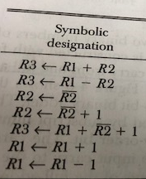
4-4 Arithmetic Microoperations Arithmetic Circuit
This circuit performs seven distinct arithmetic operations and the basic component of it is the parallel adder

Slide 10
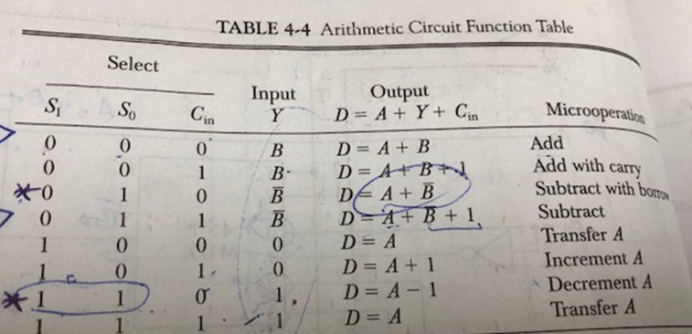
4-4 Arithmetic Microoperations Arithmetic Circuit ^{cont.}
A₃
A₂
A₁
A₀
1
0
B₃
S₁
S₀
1
0
B₂
S₁
S₀
1
0
B₁
S₁
S₀
1
0
B₀
S₁
B₃
B₂
B₁
B₀
S₀
3 2 1 0 S₁ S₀
3 2 1 0 S₁ S₀
3 2 1 0 S₁ S₀
3 2 1 0 S₁ S₀
Figure A
4×1 MUX
4×1 MUX
4×1 MUX
4×1 MUX
Y₃
X₃
Y₂
X₂
Y₁
X₁
Y₀
X₀
C₃
C₂
C₁
C_{in}
FA
FA
FA
FA
C_{out}
D₃
D₂
D₁
D₀
4-bit Arithmetic Circuit

Slide 11
4-5 Logic Microoperations
Hardware Implementation
The hardware implementation of logic microoperations requires that logic gates be inserted for each bit or pair of bits in the registers to perform the required logic function
Most computers use only four (AND, OR, XOR, and NOT) from which all others can be derived.

Slide 12
4-5 Logic Microoperations
Hardware Implementation ^{cont.}
S₁
4×1 MUX
S₁ | S₀ | Output | Operation
0 | 0 | E = A ⊕ B | XOR
0 | 1 | E = A ∨ B | OR
1 | 0 | E = A ∧ B | AND
1 | 1 | E = A | Complement
S₀
A_{i}
B_{i}
0
1
E_{i}
2
3
This is for one bit i

Slide 13
4-6 Shift Microoperations
Used for serial transfer of data
Also used in conjunction with arithmetic, logic, and other data-processing operations
The contents of the register can be shifted to the left or to the right
As being shifted, the first flip-flop receives its binary information from the serial input
Three types of shift: Logical, Circular, and Arithmetic

Slide 14
4-6 Shift Microoperations ^{cont.}
Serial Input
r_{n-1}
r₃
r2
r₁
r₀
Serial Output
Determines the “shift” type
Shift Right
Serial Output
Serial Input
r_{n-1}
r₃
r₂
r₁
r₀
Shift Left
**Note that the bit ri is the bit at position (i) of the register

Slide 15
4-6 Shift Microoperations:
Circular Shifts (Rotate Operation)
Circulates the bits of the register around the two ends without loss of information
Circular Shift Right: R1←cir R1
Circular Shift Left: R2←cil R2
The same
The same
r_{n-1}
r₃
r₂
r₁
r₀
Circular Shift Left

Slide 16
4-6 Shift Microoperations
Arithmetic Shifts
Shifts a signed binary number to the left or right
An arithmetic shift-left multiplies a signed binary number by 2: ashl (00100): 01000
An arithmetic shift-right divides the number by 2
ashr (00100) : 00010
An overflow may occur in arithmetic shift-left, and occurs when the sign bit is changed (sign reversal)

Slide 17
4-6 Shift Microoperations
Arithmetic Shifts ^{cont.}
r_{n-1}
r₃
r₂
r₁
r₀
?
Sign Bit
Arithmetic Shift Right
?
r_{n-1}
r₃
r₂
r₁
r₀
0
Sign Bit
Arithmetic Shift Left

Slide 18
4-6 Shift Microoperations
Arithmetic Shifts ^{cont.}
An overflow flip-flop V_{s} can be used to detect an arithmetic shift-left overflow
V_{s} = R_{n-1} ⊕ R_{n-2}
R_{n-1}
1 → overflow
0 → no overflow
V_{s}=
R_{n-2}

Slide 19
4-6 Shift Microoperations ^{cont.}
Example: Assume R1=11001110, then:
  Arithmetic shift right once : R1 = 11100111
  Arithmetic shift right twice : R1 = 11110011
  Arithmetic shift left once : R1 = 10011100
  Arithmetic shift left twice : R1 = 00111000
  Logical shift right once : R1 = 01100111
  Logical shift left once : R1 = 10011100
  Circular shift right once : R1 = 01100111
  Circular shift left once : R1 = 10011101

Slide 20
4-6 Shift Microoperations
Hardware Implementation ^{cont.}
Serial Input I_{R}
Serial Input I_{L}
A₃
A₂
A₁
A₀
Select
0 for shift right
1 for shift left
S
1
0
S
1
0
S
1
0
S
1
0
MUX
MUX
MUX
MUX
H₃
H₂
H₁
H₀
Figure B
4-bit Combinational Circuit Shifter

Slide 21
Putting things Together
4-7 Arithmetic Logic Shift Unit
Instead of having individual registers performing the microoperations directly, computer systems employ a number of storage registers connected to a common operational unit called an Arithmetic Logic Unit (ALU)

Slide 22

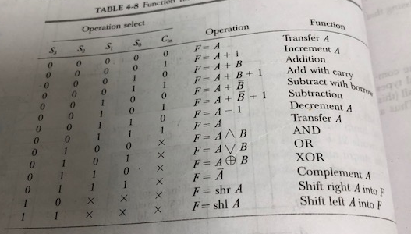
Supported Operations

Slide 23
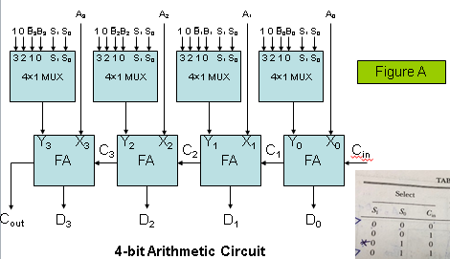
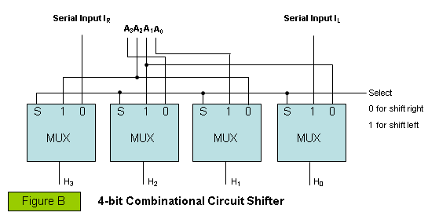
4-7 Arithmetic Logic Shift Unit ^{cont.}
S₃
S₂
S₁
C_{i}
S₀
One stage of arithmetic circuit (Fig.A)
D_{i}
One stage of ALU
Select
F_{i}
C_{i+1}
0
4×1 MUX
1
One stage of logic circuit (Fig.B)
E_{i}
2
B_{i}
3
A_{i}
A_{i+1}
shr
A_{i-1}
shl

